Slide 1

Fingerprint Based Biometric Attendance System
Supervised By
Prottoy Saha
Lecturer
Department of Computer Science and Engineering
Khulna University of Engineering & Technology
Presented by
Projapoti Roy
Roll:1607041
Sharia Wasika Aditi
Roll:1607109

Slide 2
Introduction to our system
To Introduce a new system to the educational era.
To design fingerprint based biometric attendance system.
To enroll fingers of the students for the system.
To take attendance of the students.

Slide 3
Features
Data Storage
All the attendance details are stored in a storage
03
Fingerprint Enrollment
Fingers are enrolled for the system.
01
02
Taking Attendance
In this stage, attendance are taken from the studnets.

Slide 4

Fingerprint enrollment

Slide 5
FingerPrint Enrollment
To enroll fingers, press key ‘B’
To select ID, press key ‘C’ or ‘D’
To proceed with selected ID press key ‘#’

Slide 6
FingerPrint Enrollment CONTD..
The following stages are internally maintained in the fingerprint module while enrolling a finger –
Image Acquisition
Image Enhancement
Edge Detection
Extraction of Miniature points

Slide 7
FingerPrint Enrollment CONTD..
Image Acquisition:
Determine fingerprint image quality.
Use Live scan digital image.
Image Enhancement:
Improve the clarity of ridge and valley of acquired image.
Histogram equalization method.

Slide 8
FingerPrint Enrollment CONTD...
Edge Detection:
Prewitt operator for edge detection.
Horizontal edges & vertical edges.
Match the input image with already saved image.
Extraction of miniature points:
Miniature points

Slide 9
Taking Attendance

Slide 10
Taking Attendance
s <= t?
Start
Yes
Here, s is student check in time & t equals to class starts time + 15 minutes
Input Course No
Yes
No
Fingerprint is matched?
Present
Late Consideration
Setup Class Date & Time
Display Student’s ID on the LCD with a message
No
Process of scanning & searching fingerprint
Display Date & Time
Save present ID’s details in SD card
Press A for Attendance
Place Finger
End
Fig 1 : Flowchart of taking attendance

Slide 11
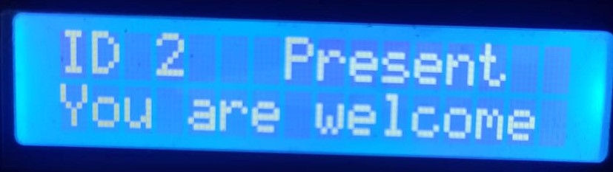
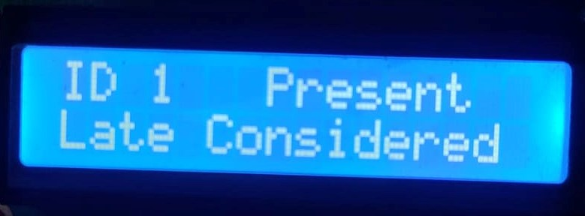
Taking Attendance CONTD..
The following messages are shown in LCD display after giving attendance –
Fig 2(i): Within time
Fig 2(ii): Late Consideration

Slide 12
Taking Attendance CONTD..
We have maintained following rules for marking attendance of a student –
Place finger correctly.
i. Failure to enroll rate (FTE)
ii. Failure to capture rate (FTC)
Mark attendance within first 15 minutes of class time.

Slide 13
Data STorage

Slide 14
Data Storage
Stored attendance details in SD card.
Save attendance details in a .txt file.
Extracted the file into excel sheet.

Slide 15
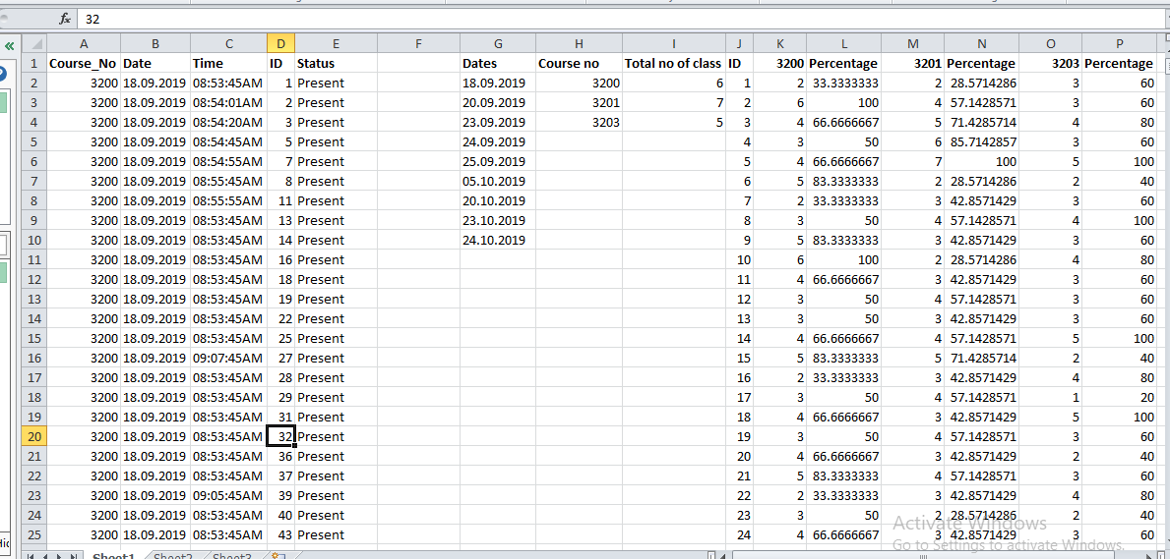
Data Storage Contd..
Fig 3: Student Attendance Excel Sheet

Slide 16
Hardware design

Slide 17
Hardware design
Fingerprint Module
Computer
SD Card Module
Arduino Mega
LCD Display
Keypad
RTC Module
(DS3231)
Fig 4: Block Diagram of Biometric Attendance System

Slide 18
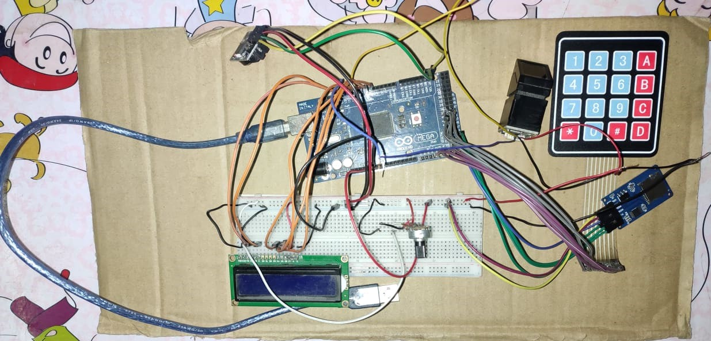
Hardware design CONTd..
Fig 5: Prototype Design of our proposed system

Slide 19
Result ANalysis

Slide 20
Result Analysis
Class | Attempted Students | Successful Identification | Unsuccessful Identification | Accuracy
Day 1 | 72 | 70 | 2 | 97.22%
Day 2 | 77 | 76 | 1 | 98.70%
Day 3 | 68 | 67 | 1 | 98.53%
Day 4 | 72 | 70 | 2 | 97.22%
Day 5 | 70 | 69 | 1 | 98.57%
Day 6 | 79 | 76 | 3 | 96.20%
Day 7 | 69 | 67 | 2 | 97.10%
Fig 6: Accuracy Table

Slide 21
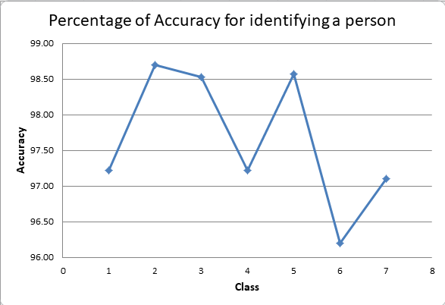
Result Analysis contd..
Fig 7 : Accuracy graph

Slide 22
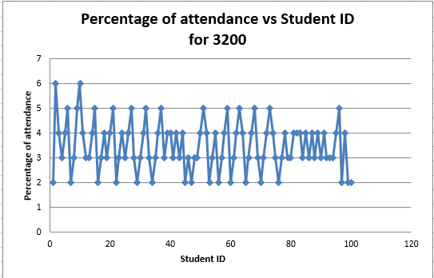
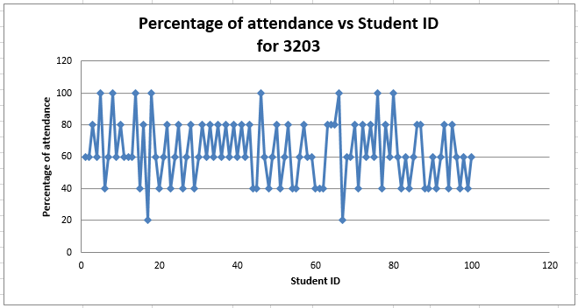
Result Analysis contd..
Fig 8 : Attendance percentage of students in different courses

Slide 23
limitations
Misplacement of fingers.
Physical changes in fingers.

Slide 24
Conclusion
An applicable attendance system has been designed for educational organizations in this project. If this project can be designed practically, it would help to reduce many issues such as denying the possibilities of cheating in recording the attendance, help to ease the lecturers to keep track of student’s attendance, there will be no anonymous fingerprint which is able to tamper with the recorded data, and it saves time in taking attendance instead of queuing in a line.

Slide 25
Thanks Everyone!

